Slide 1
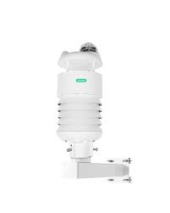
Forecasting Daily Air Temperature in Doho, Uganda Using Machine Learning and Deep Learning
Accurate Temperature Predictions for Agriculture, Energy, and Disaster Preparedness

Slide 2
Problem Statement & Justification
Problem:
Predict daily air temperature using historical weather data (2013–2016) in Doho, Uganda.
Accurate forecasts help farmers, energy providers, disaster management authorities, and urban planners.
Justification:
Weather data is sequential → temporal models like LSTM capture trends.
Feature engineering (lags, rolling stats, date-based features) improves model performance.
Supports data-driven decisions in agriculture, energy, and disaster preparedness.

Slide 3
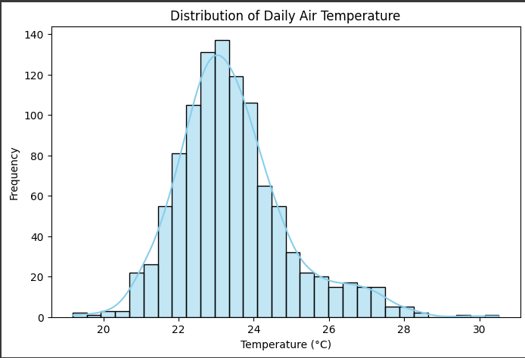
Data & Feature Engineering
Feature Engineering:
Lag variables: 1,2,3,7,14 days
Rolling statistics: 7-day mean & std
Date features: Month, Day-of-Year, Weekday
One-hot encoded station identifiers
Dataset:
Daily observations from multiple stations (Temperature, Humidity, Min/Max Temp, Station ID).

Slide 4
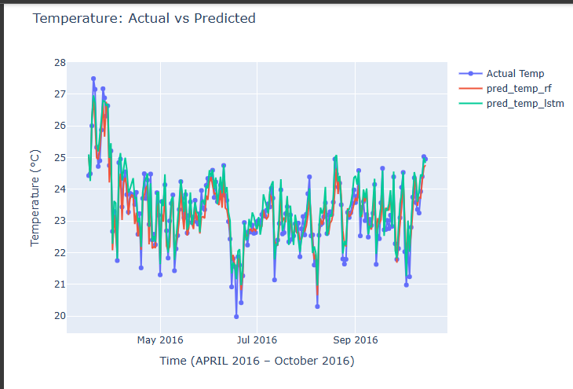
Modeling Approach & Metrics
Models Used:
Random Forest Regressor (RF) – classical ML
LSTM – deep learning for sequential data
Evaluation Metrics:
Metric | Purpose
MSE | Penalizes large errors
MAE | Average absolute error
RMSE | Same units as temperature
R² | Variance explained

Slide 5
Key Results & Interpretations
Observations:
LSTM outperforms RF across all metrics.
Captures temporal dependencies better → smoother, accurate forecasts.
Residuals centered around 0 → unbiased predictions.
Model Performance:
Model | MSE | MAE | RMSE | R²
Random Forest | 0.176 | 0.332 | 0.420 | 0.872
LSTM | 0.140 | 0.301 | 0.374 | 0.898

Slide 6
Recommendations & Future Work
Recommendations for Stakeholders:
Farmers: Optimize irrigation, planting, harvesting.
Energy Providers: Plan load demand & infrastructure maintenance.
Disaster Management: Early warnings for heat/cold events.
Urban Planners & Policy Makers: Climate adaptation, urban heat planning.
Future Additions:
Include rainfall, wind speed, and humidity predictions.
Multi-station spatial modeling (Graph Neural Networks).
Ensemble modeling & real-time forecasts with dashboards/APIs.
Climate trend analysis for long-term planning.

Slide 7
GROUP SIX(6) MEMBERS
ACTIVE MEMBERS IN PROJECT
Birungi Joan
Tuhaise praise
Nyeko Samuel
Darius Twesigomwe
NON ACTIVE MEMBERS IN PROJECT
MUGIDE HAWA
Tumusiime Dennis

